Slide 1

Chapter 4
Forces and Newton’s Laws of Motion

Slide 2
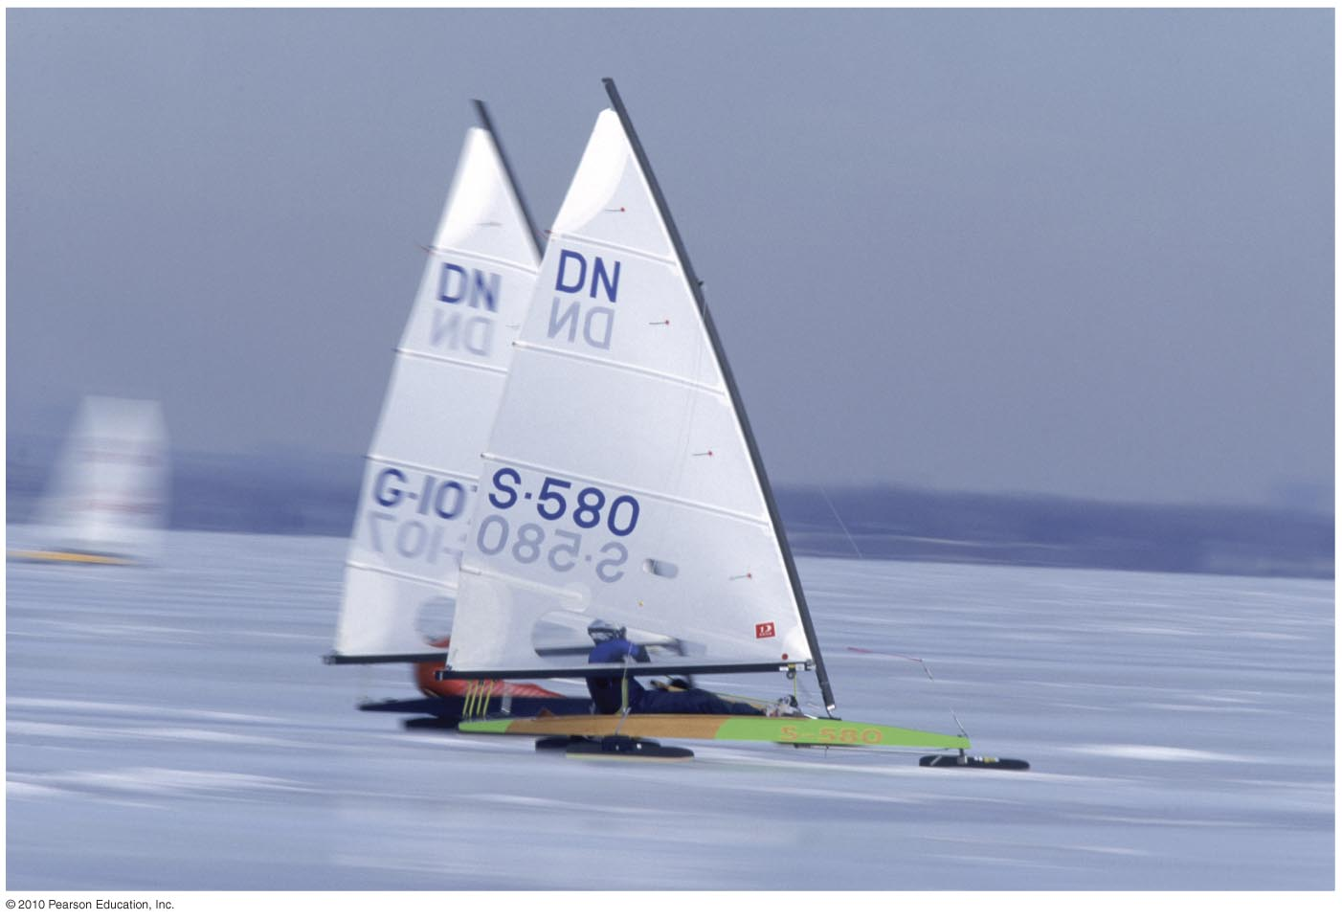
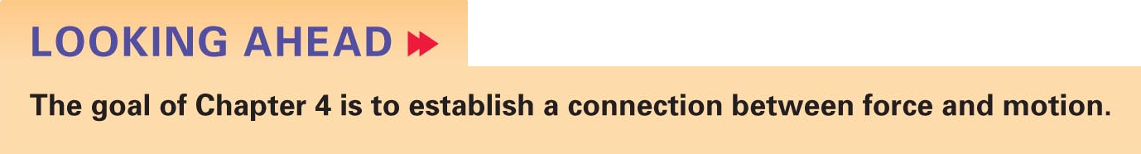

4 Forces and Newton’s Laws of Motion
Slide 4-2

Slide 3
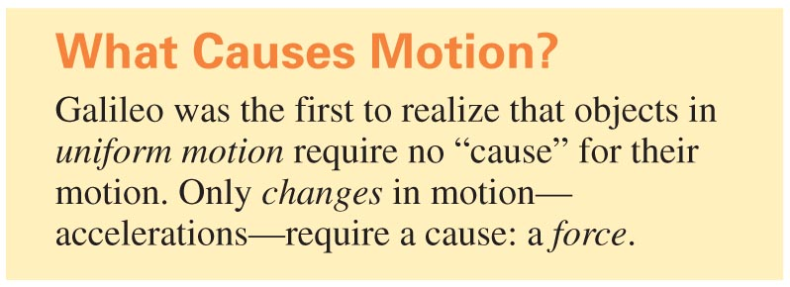
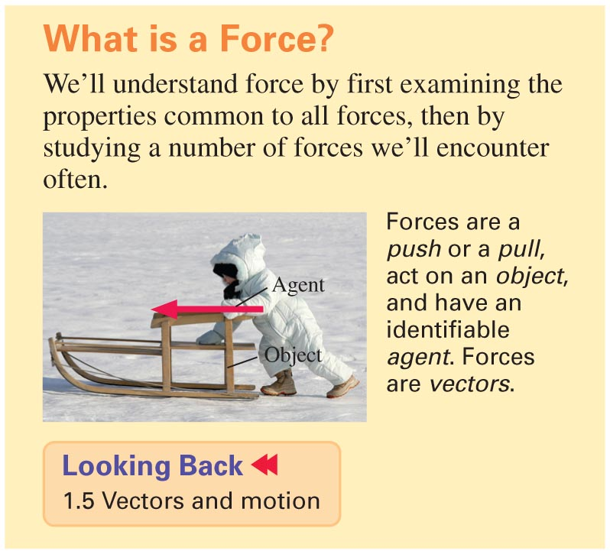
Slide 4-3

Slide 4
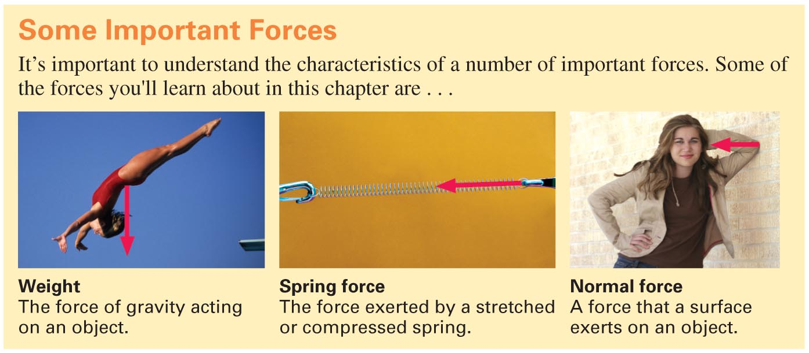
Slide 4-4

Slide 5
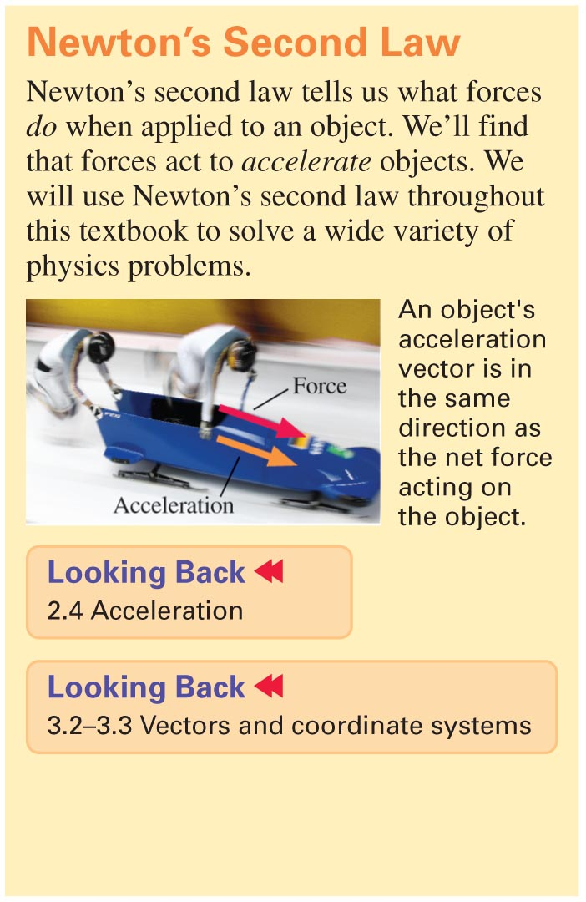
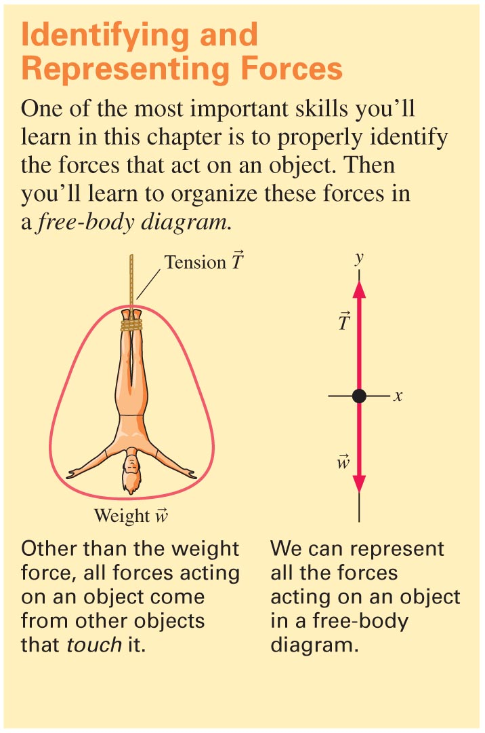
Slide 4-5

Slide 6
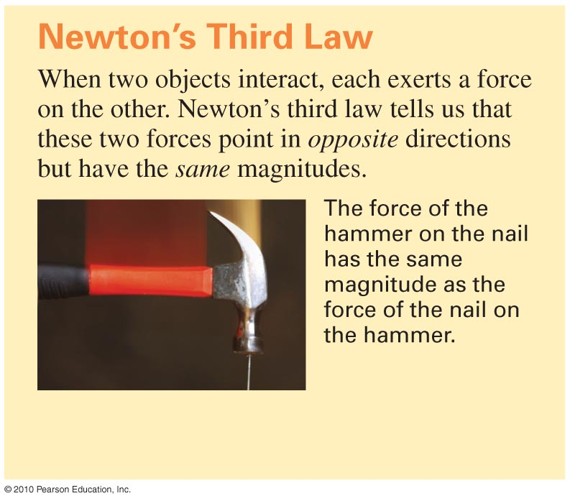
Slide 4-6

Slide 7
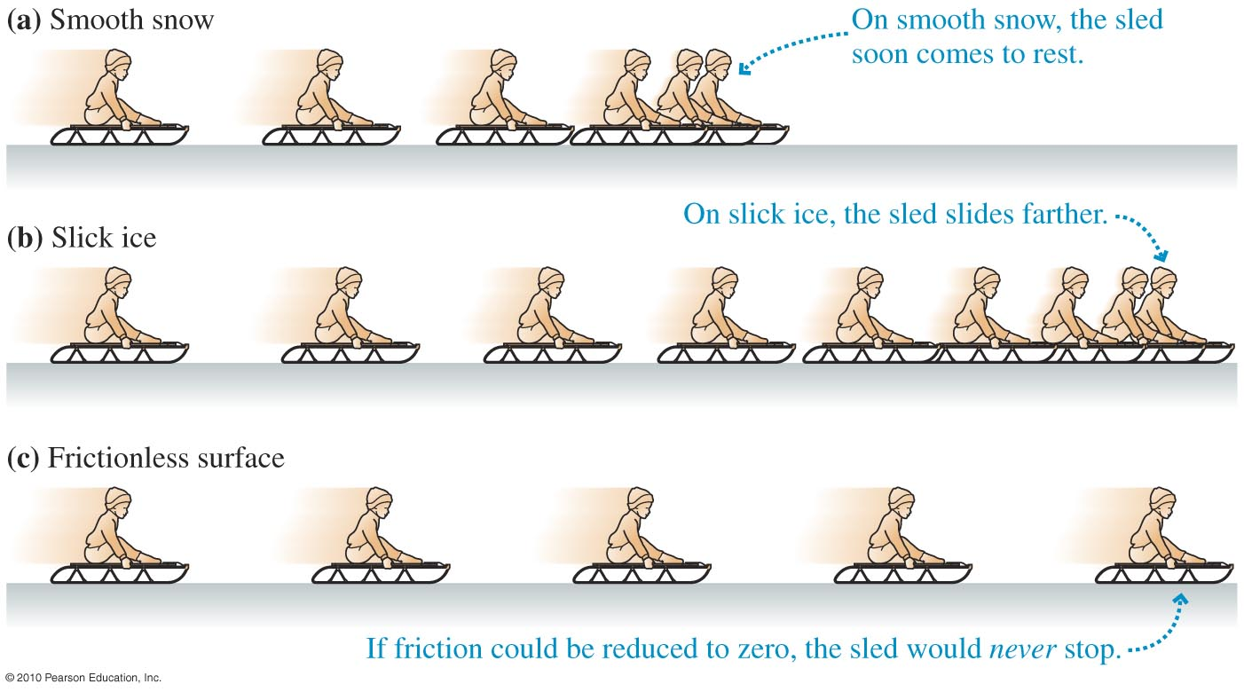
What Causes Motion?
In the absence of any forces acting on it, an object will continue moving forever. Motion needs no “cause.”
Slide 4-15

Slide 8
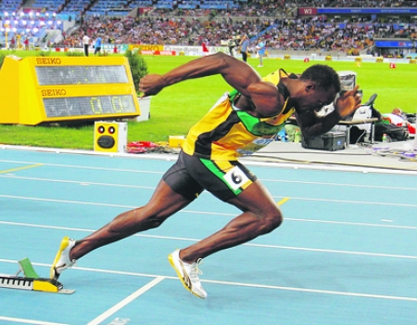
What causes motion?
Newton’s First Law: An object in uniform motion will not accelerate unless there is an external interaction

Slide 9
What causes motion?
Force from the ground on Usain

Slide 10
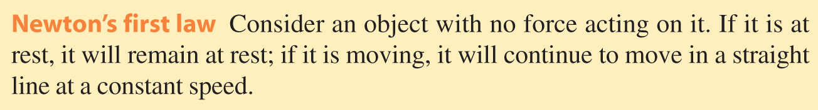
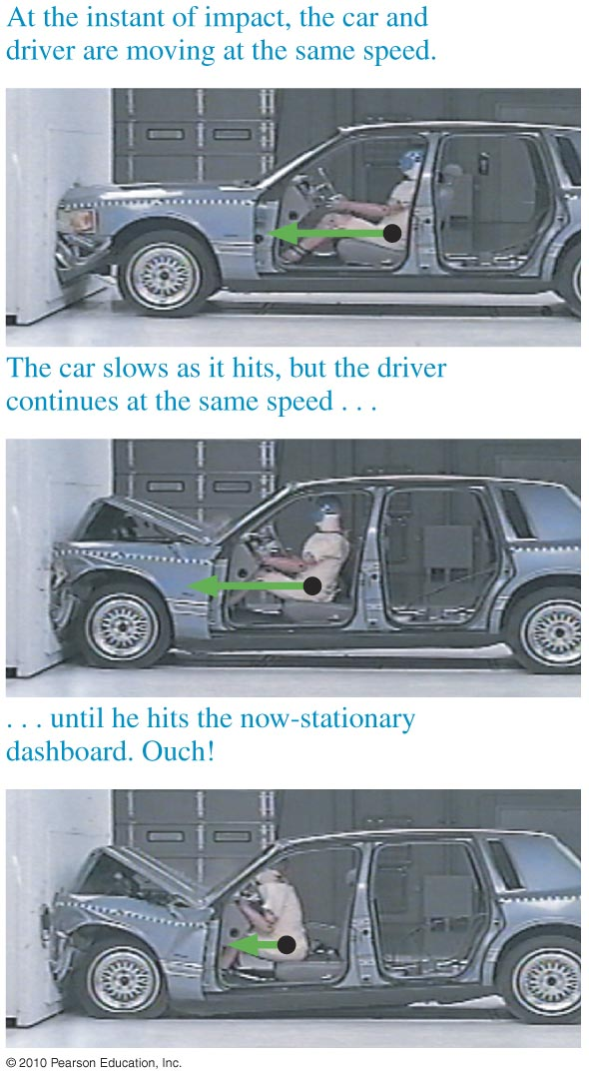
Seat Belts: An Application of Newton’s First Law
Slide 4-16

Slide 11
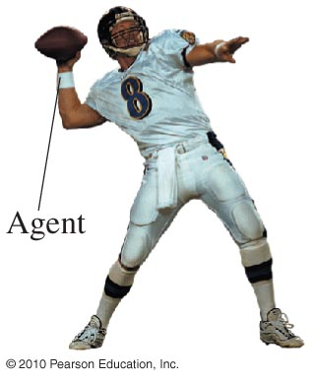

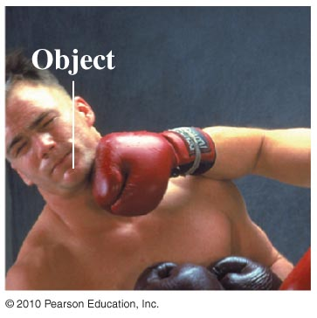
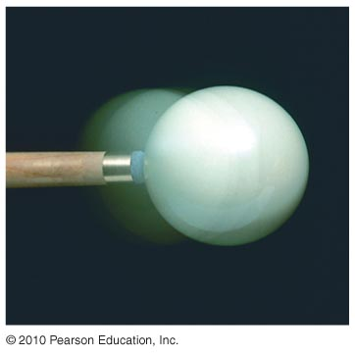
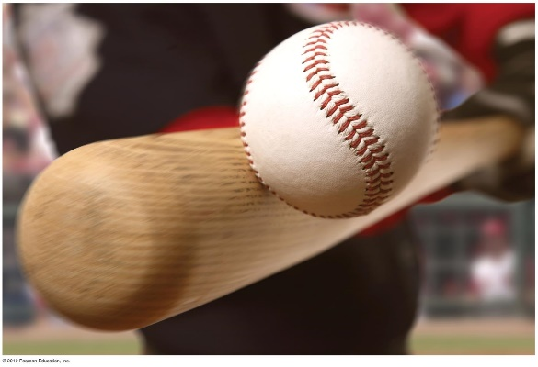
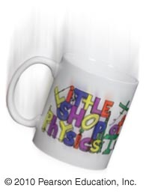
What Is a Force?
A force...
... is a push or a pull.
... acts on an object.
... requires an agent.
... is a vector.
... is a contact force or a long-range force.
Slide 4-17

Slide 12
Force Vectors
The magnitude of a force is measured in Newtons
Newtons
angle
What about multiple forces acting on one mass?

Slide 13
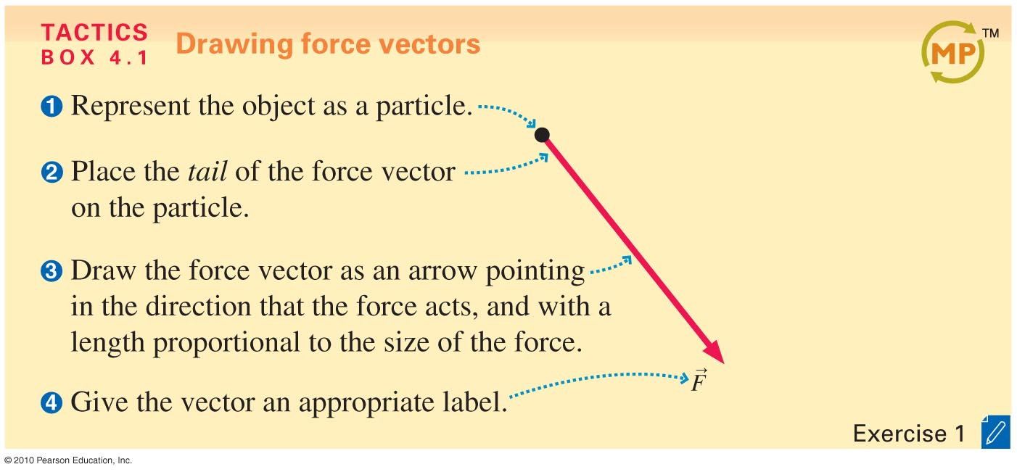
Force Vectors
Slide 4-18

Slide 14
Force is
something Yoda told Han Solo to use
a scalar quantity
a vector quantity
a unit of power

Slide 15
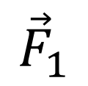
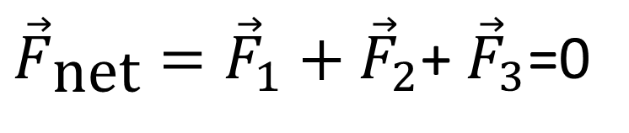
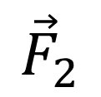
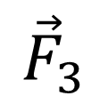
Force Vectors add too
A hanging street sign with more than one force acting on it
$${\vec{F}}_{1}$$
$${\vec{F}}_{2}$$
Worst Buy
$${\vec{F}}_{3}$$
${\vec{F}}_{\text{net}}={\vec{F}}_{1}+{\vec{F}}_{2}$+ ${\vec{F}}_{3}$=0

Slide 16
Force types
Weight
Spring
Tension
Normal
Friction
Drag
Thrust
Electromagnetic

Slide 17
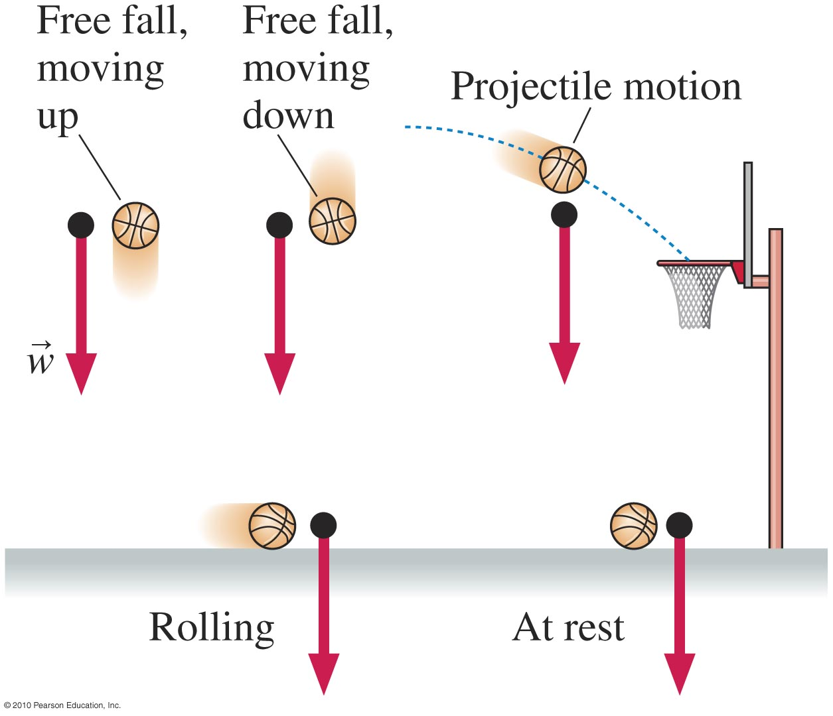
→
A Short Catalog of Forces: Weight w
Slide 4-19

Slide 18
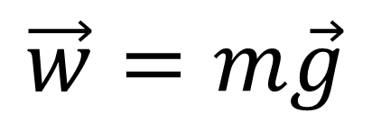
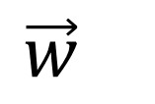
Weight
Gravity pulling down
$$\vec{w}=m\vec{g}$$
$${\vec{w}}_{}$$
Is your weight the same on the moon?

Slide 19
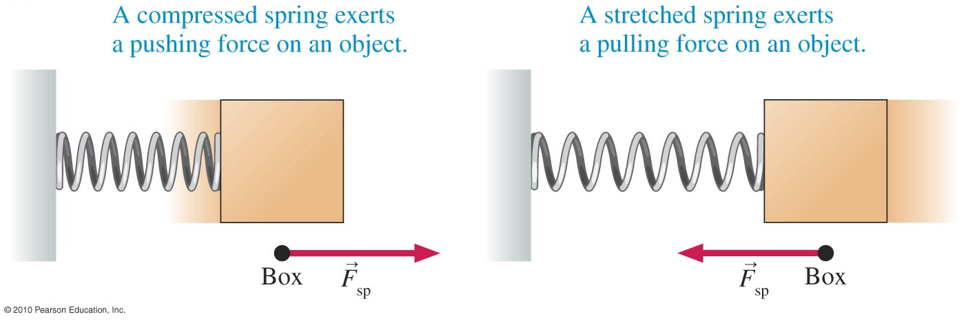
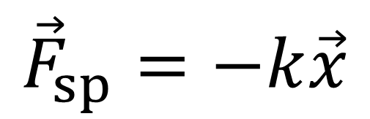
→
Spring Force F_{sp}
$${\vec{F}}_{sp}=−k\vec{x}$$
Slide 4-20

Slide 20
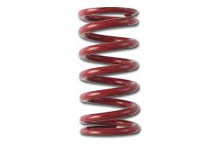
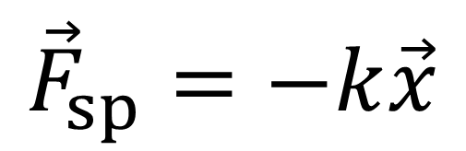
Spring
When a coiled spring is displaced from equilibrium it wants to return
$${\vec{F}}_{sp}=−k\vec{x}$$

Slide 21
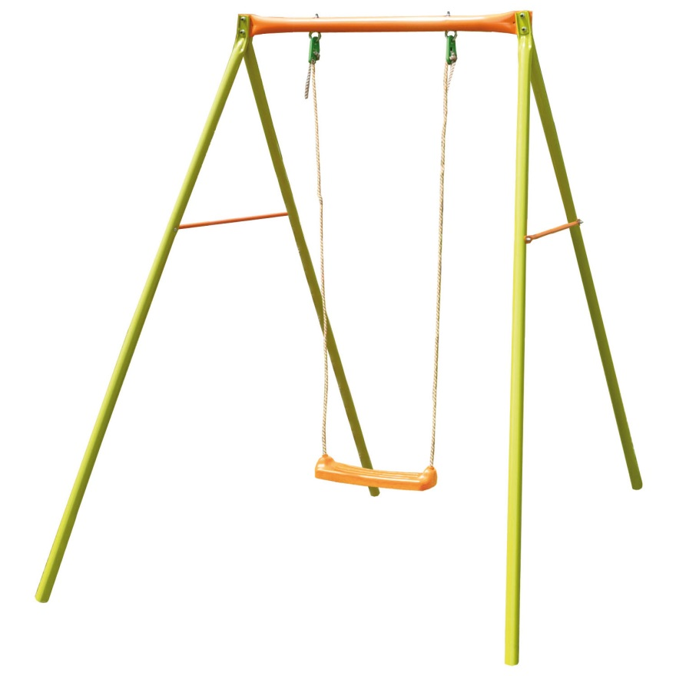
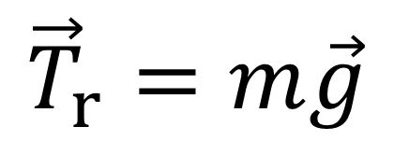
Tension
Found in ropes, chains, cloth
$${\vec{T}}_{r}=m\vec{g}$$

Slide 22
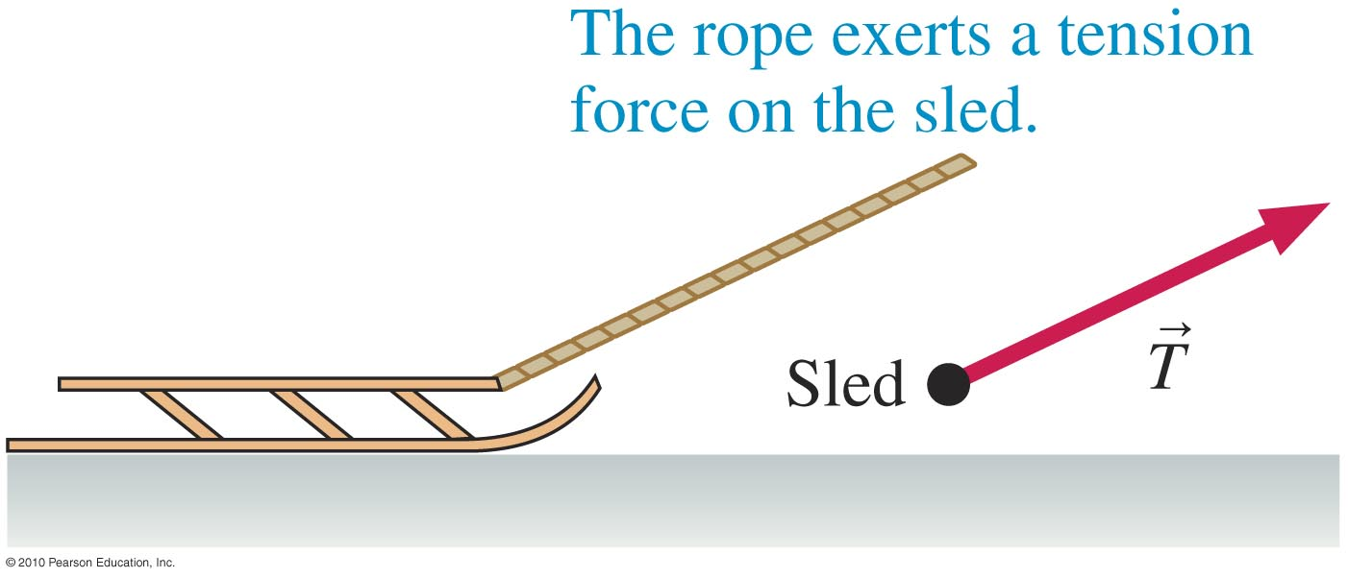
→
Tension ForceT
Slide 4-21

Slide 23

Normal
Perpendicular to the surface of interacting objects

Slide 24

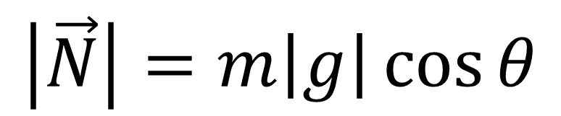





Normal
Perpendicular to the surface of interacting objects
$$\left|\vec{N}\right|=m\left|g\right|\cos{θ}$$
$$y$$
$$θ$$
$$x$$
$$mg\cos{θ}$$
$$mg$$
$$θ$$

Slide 25





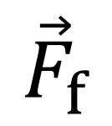
Friction
Resistance to motion from interactions with other surfaces
$${\vec{F}}_{f}$$
$$y$$
$$x$$
$$θ$$
$$mg$$
$$mg\sin{θ}$$
$$θ$$

Slide 26
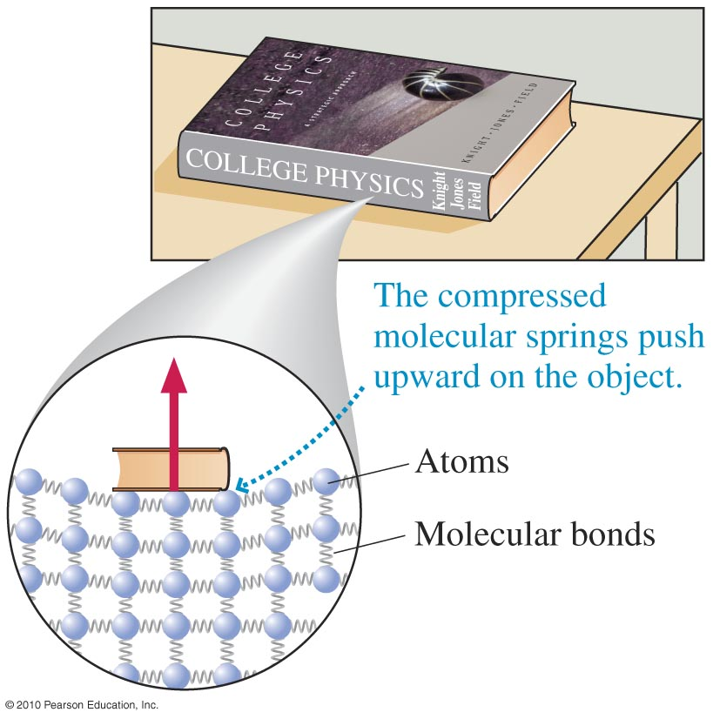
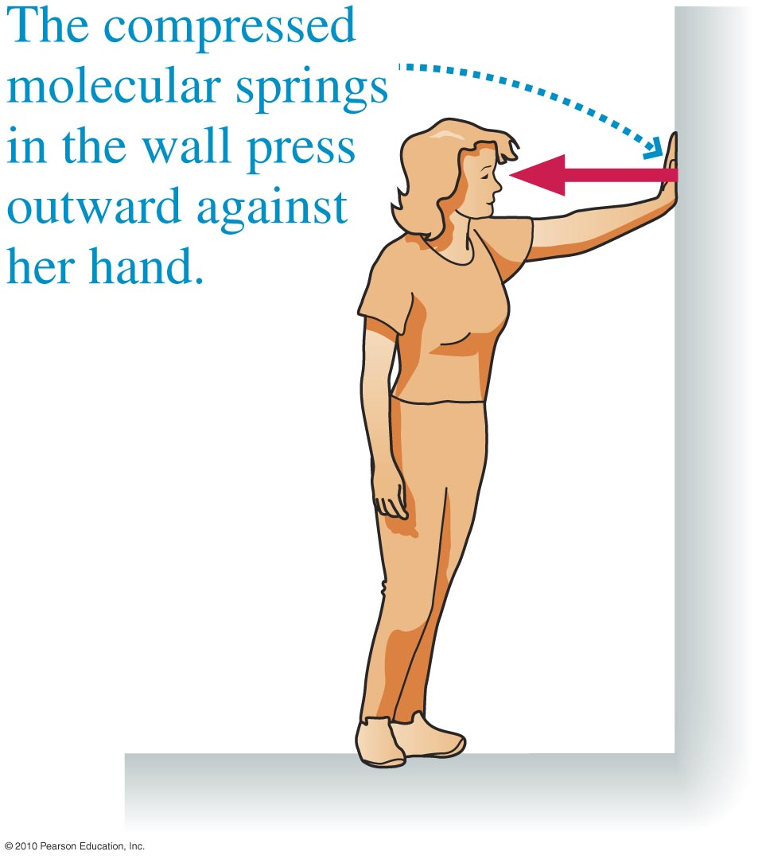
→
Normal Force n
Slide 4-22

Slide 27
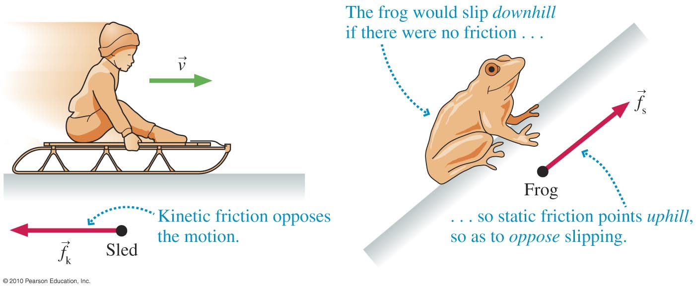
→
→
Friction f_{k} and f_{s}
Slide 4-23

Slide 28
Drag
Resistance to motion through a fluid

Slide 29
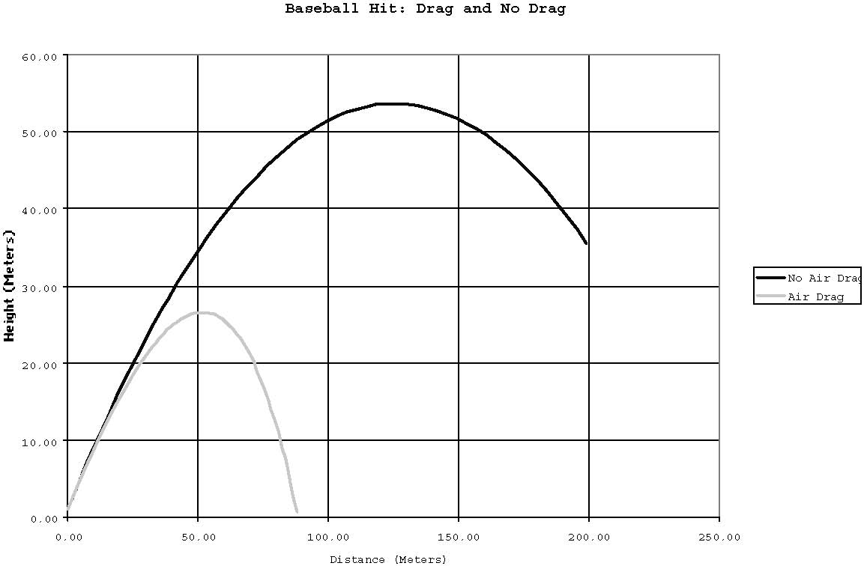
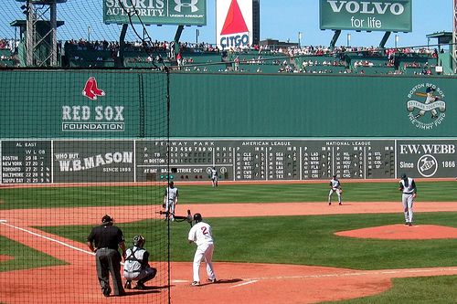
Parabola
Fenway Park (Red Sox) 420 feet dead center 32 feet high

Slide 30
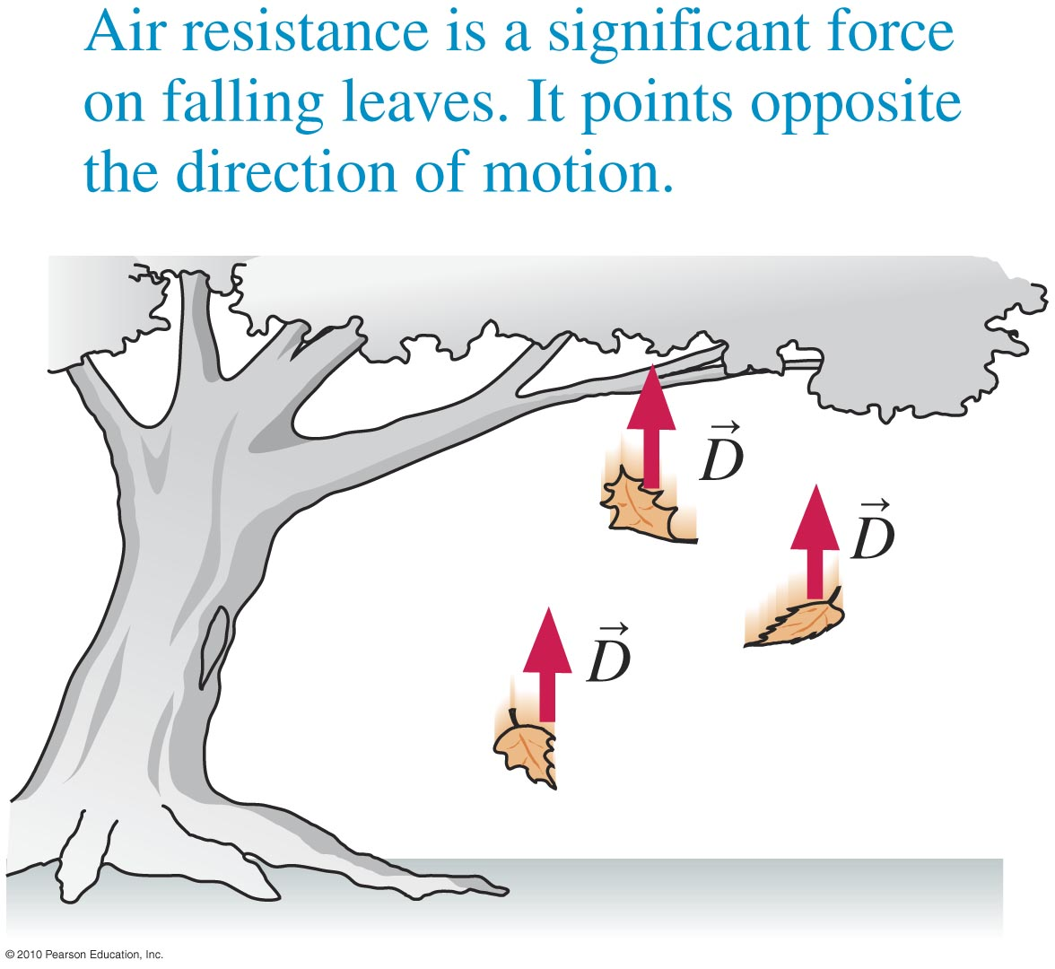
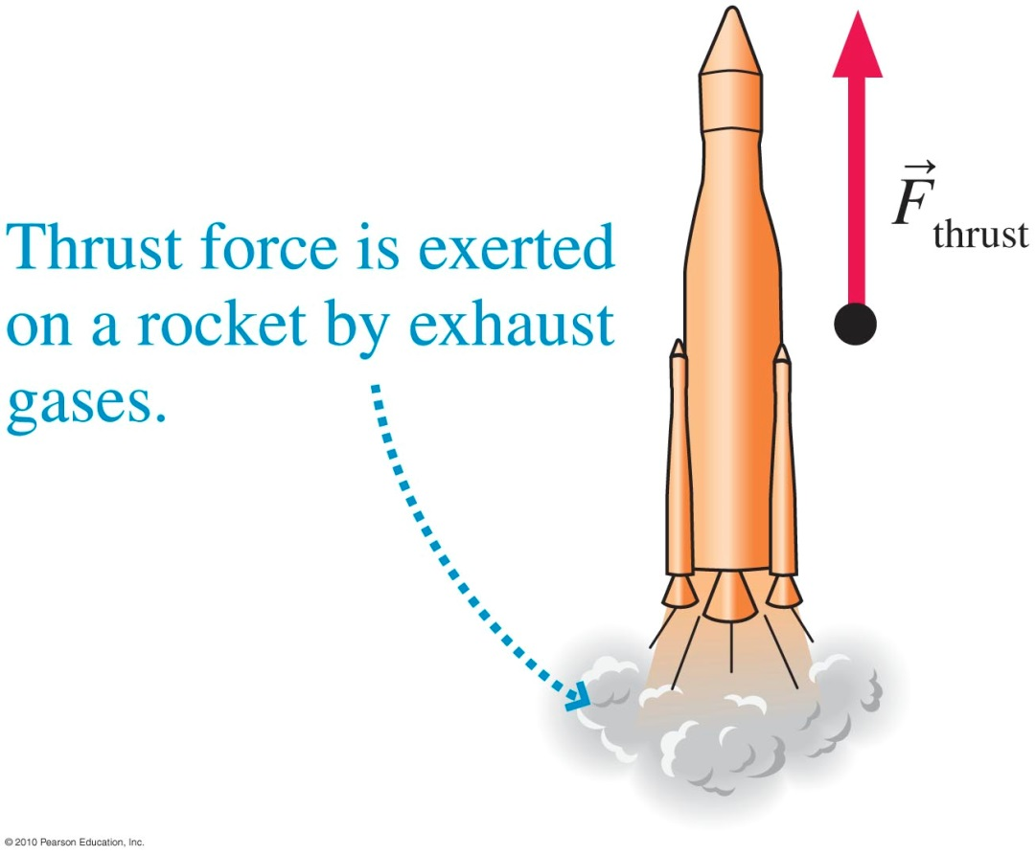
→
→
Drag D and Thrust F_{thrust}
Slide 4-24

Slide 31

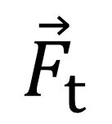



Thrust
Exerted when mass is released
$${\vec{F}}_{t}$$
$$v_{4}$$
$$v_{1}$$
m
m
$$v_{3}$$
m
m
$$v_{2}$$

Slide 32
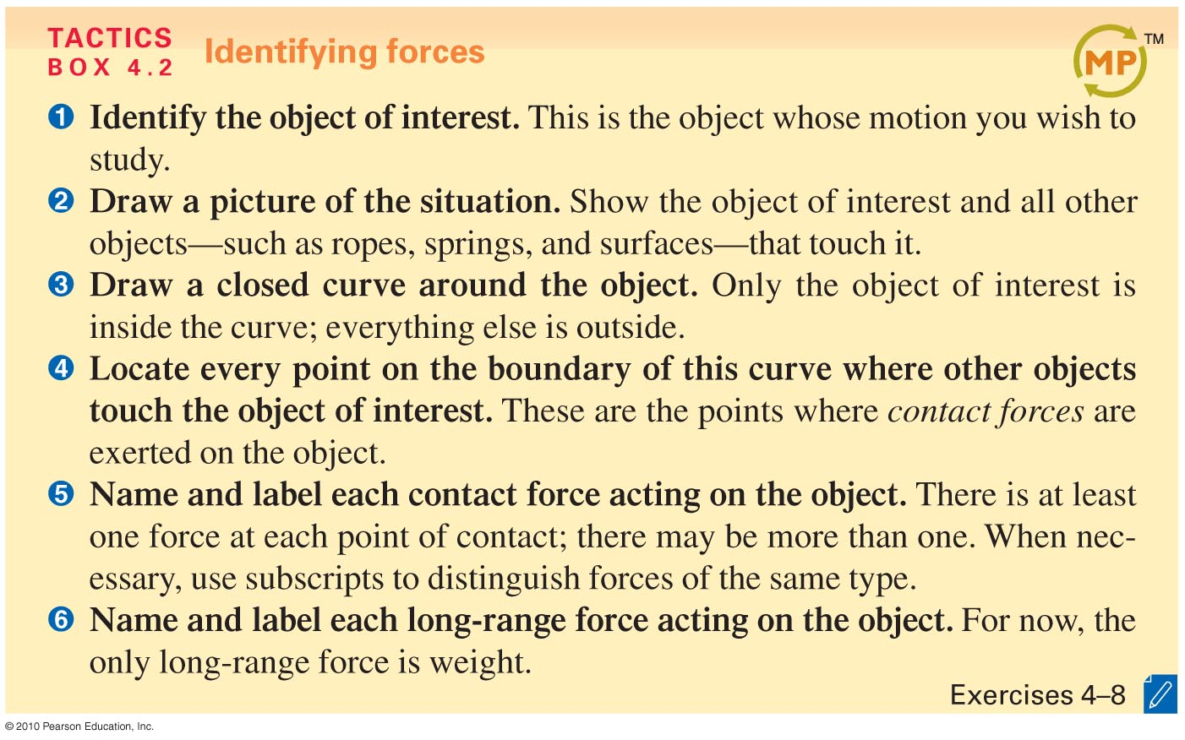
Identifying Forces
Slide 4-25

Slide 33
The force on an object at an interface is called the
natural force.
nurturing force
normal force
negligible force

Slide 34






Example Problem
A block is dragged uphill by a rope. Identify all forces acting on the block.
$${\vec{T}}_{R}$$
$${\vec{F}}_{N}$$
$${\vec{F}}_{f}$$
$${\vec{F}}_{g}$$
Slide 4-26

Slide 35



Example Problem
Block A hangs from the ceiling by a rope. Another block B hangs from A. Identify the forces acting on A.
$${\vec{T}}_{1}$$
$${\vec{T}}_{2}$$
$${\vec{F}}_{g1}$$
Slide 4-27

Slide 36
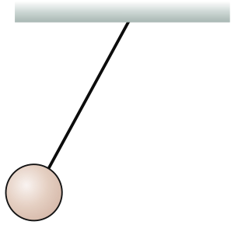


Example Problem
A ball, hanging from the ceiling by a string, is pulled back and released. Identify the forces acting on it just after its release.
$${\vec{T}}_{s}$$
$${\vec{F}}_{g}$$
Slide 4-28

Slide 37
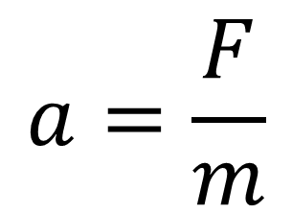
Newton’s Second Law
An object’s acceleration is directly proportional to Force and inversely proportional to mass
F
m
$$a=\frac{F}{m}$$

Slide 38

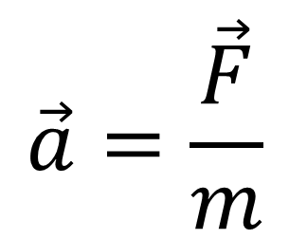
Newton’s Second law
Force is a vector, so acceleration is too
$$\vec{F}$$
$$\vec{a}=\frac{\vec{F}}{m}$$
m
How many masses are seen here?… 1 VERY IMPORTANT

Slide 39
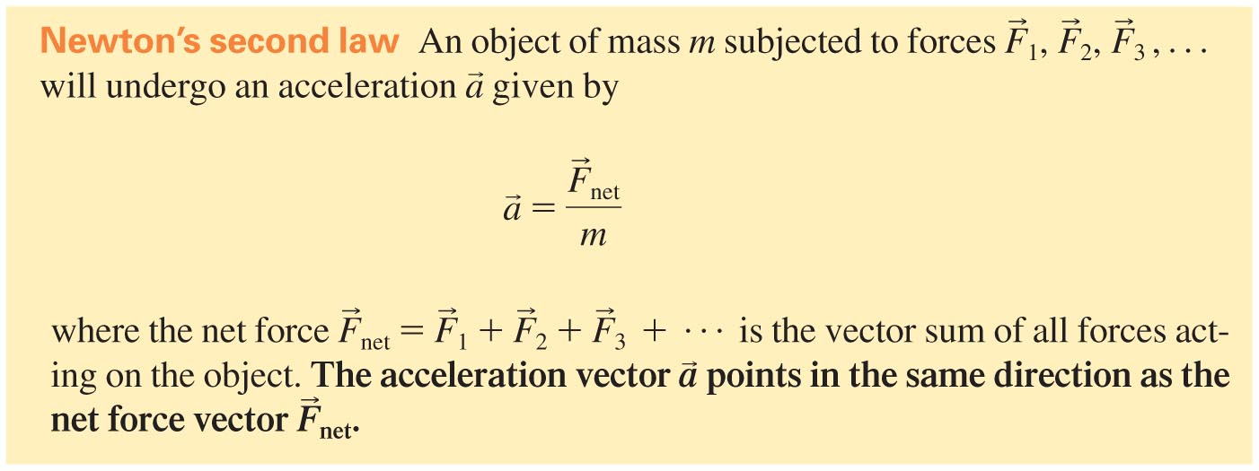
Newton’s Second Law
Slide 4-29

Slide 40
Newton’s second law states:
The force on a weight is equal to its velocity times gravity.
The force of an object equals its acceleration divided by its mass.
The force on an object is equal to its mass multiplied by the rate of change of its velocity.
The force on a mass is equal to the distance pushed times work done on the mass.

Slide 41


Example Problem
An elevator, lifted by a cable, is going up at a steady speed.
Identify the forces acting on the elevator.
Is T greater than, equal to, or less than w? Or is there not enough information to tell?
$${\vec{T}}_{c}$$
$${\vec{F}}_{g}$$
Slide 4-30

Slide 42



Free Body Diagrams
Draw all forces acting on the mass in question
$${\vec{F}}_{\text{N}}$$
m
$$Σ\vec{F}=0$$
$$\vec{w}$$

Slide 43





Free Body Diagrams
If the object is accelerating draw an acceleration vector away from the object
$${\vec{F}}_{\text{N}}$$
$$\vec{a}$$
m
$${\vec{F}}_{\text{s}}$$
$$Σ\vec{F}=m\vec{a}$$
$$\vec{w}$$

Slide 44

Free-Body Diagrams
Slide 4-31

Slide 45


Newton’s Third Law
Every force occurs as one member of an action/reaction pair of forces
$${\vec{F}}_{\text{N}}$$
m
$$\vec{w}$$

Slide 46


Newton’s Third Law
Slide 4-32

Slide 47

Checking Understanding
An object, when pushed with a net force F, has an acceleration of 2 m/s². Now twice the force is applied to an object that has four times the mass. Its acceleration will be
½ m/s².
1 m/s².
2 m/s².
4 m/s².
Slide 4-33
Notes:
Answer: B

Slide 48
Answer
An object, when pushed with a net force F, has an acceleration of 2 m/s². Now twice the force is applied to an object that has four times the mass. Its acceleration will be
½ m/s².
1 m/s².
2 m/s².
4 m/s².
Slide 4-34
Notes:
Answer: B

Slide 49
Checking Understanding
A 40-car train travels along a straight track at 40 mph. A skier speeds up as she skis downhill. On which is the net force greater?
The train.
The skier.
The net force is the same on both.
There’s not enough information to tell.
Slide 4-35
Notes:
Answer: B

Slide 50
Answer
A 40-car train travels along a straight track at 40 mph. A skier speeds up as she skis downhill. On which is the net force greater?
The train.
The skier.
The net force is the same on both.
There’s not enough information to tell.
Slide 4-36
Notes:
Answer: B

Slide 51
Checking Understanding
10-year-old Sarah stands on a skateboard. Her older brother Jack starts pushing her backward and she starts speeding up. The force of Jack on Sarah is
greater than the force of Sarah on Jack.
equal to than the force of Sarah on Jack.
less than the force of Sarah on Jack.
Slide 4-37
Notes:
Answer: B

Slide 52
Answer
10-year-old Sarah stands on a skateboard. Her older brother Jack starts pushing her backward and she starts speeding up. The force of Jack on Sarah is
greater than the force of Sarah on Jack.
equal to than the force of Sarah on Jack.
less than the force of Sarah on Jack.
Slide 4-38
Notes:
Answer: B

Slide 53

Summary
Slide 4-39

Slide 54

Summary
Slide 4-40

Slide 55

Summary
Slide 4-41

Slide 56
Reading Quiz
A “net force” is
the sum of the magnitudes of all the forces acting on an object.
the difference between two forces that are acting on an object.
the vector sum of all the forces acting on an object.
the force with the largest magnitude acting on an object.
Slide 4-7
Notes:
Answer: C

Slide 57
Answer
A “net force” is
the sum of the magnitudes of all the forces acting on an object.
the difference between two forces that are acting on an object.
the vector sum of all the forces acting on an object.
the force with the largest magnitude acting on an object.
Slide 4-8
Notes:
Answer: C

Slide 58
Reading Quiz
Which of the following is NOT one of the steps used to identify the forces acting on an object?
Name and label each force the object exerts on the environment.
Name and label each contact force acting on the object.
Draw a picture of the situation.
Identify “the system” and “the environment.”
Name and label each long-range force acting on the object.
Slide 4-9
Notes:
Answer: A

Slide 59
Answer
Which of the following is NOT on of the steps used to identify the forces acting on an object?
Name and label each force the object exerts on the environment.
Name and label each contact force acting on the object.
Draw a picture of the situation.
Identify “the system” and “the environment.”
Name and label each long-range force acting on the object.
Slide 4-10
Notes:
Answer: A

Slide 60
Reading Quiz
Which of these is not a force discussed in this chapter?
The tension force.
The normal force.
The orthogonal force.
The thrust force.
Slide 4-11
Notes:
Answer: C

Slide 61
Answer
Which of these is not a force discussed in this chapter?
The tension force.
The normal force.
The orthogonal force.
The thrust force.
Slide 4-12
Notes:
Answer: C

Slide 62
Reading Quiz
An action/reaction pair of forces
point in the same direction.
act on the same object.
are always long-range forces.
act on two different objects.
Slide 4-13
Notes:
Answer: D

Slide 63
Answer
An action/reaction pair of forces
point in the same direction.
act on the same object.
are always long-range forces.
act on two different objects.
Slide 4-14
Notes:
Answer: D

Slide 64
MCAT style question
The sum of the three forces acting on the center point of the rope is assumed to be zero because…
This point has a very small mass
Tension forces in a rope always cancel
The point is not accelerating
The angle of deflection is very small

Slide 65
MCAT style question
When you are pulling on the rope as shown, what is the approximate direction of the tension force on the tree?
North
South
East
West

Slide 66
MCAT style question
Assume that you are pulling on the rope, but the car is not moving. What is the approximate direction of the force from the mud on the car?
North
South
East
West

Slide 67
MCAT style question
Suppose your efforts work and the car begins to move forward out of the mud. As it does so, the force of the car on the rope is…
zero
Less than the force of the rope on the car
Equal to the force of the rope on the car
Greater than the force of the rope on the car

